Slide 1
KOKO
Gift Voucher Text V3 - 26 Nov

Slide 2
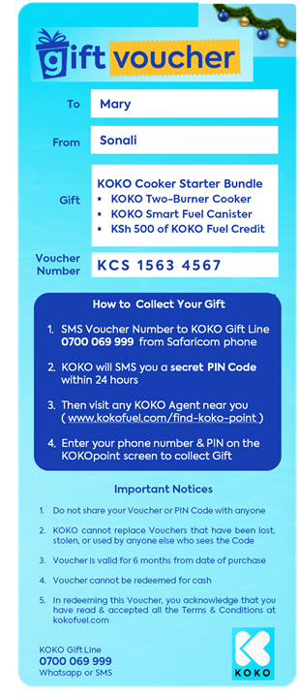
Changes in v2:
Portrait layout to suit phone format
PDF will be custom page size
Voucher number = KCS, KCM or KCM (to identify bundle) + plus random number
PDF includes URLs (e.g. to find KP)
Total KSh Value removed from Voucher
Only contact point is the Gift Line number, not the other KOKO Numbers
Subsequent 3 pages of PDF contain info from KOKO Brochure introducing KOKO Cooker, etc. (edited slightly, with price & contact numbers removed, etc.)
Page 2, 3, 4 with info from KOKO Brochure

Slide 3
Voucher Text V1

Slide 4


Slide 5
